Slide 1

G2M Case Study
Virtual Internship
20-Jan-2021

Slide 2
Background –G2M(cab industry) case study
XYZ is a private equity firm in US. Due to remarkable growth in the Cab Industry in last few years and multiple key players in the market, it is planning for an investment in Cab industry.
Objective : Provide actionable insights to help XYZ firm in identifying the right company for making investment.
The analysis has been divided into four parts:
Data Loading and Preparation
Data Exploration
Analysis of Data through various aspects such as Profit, Demand and Season
Recommendations for investment

Slide 3
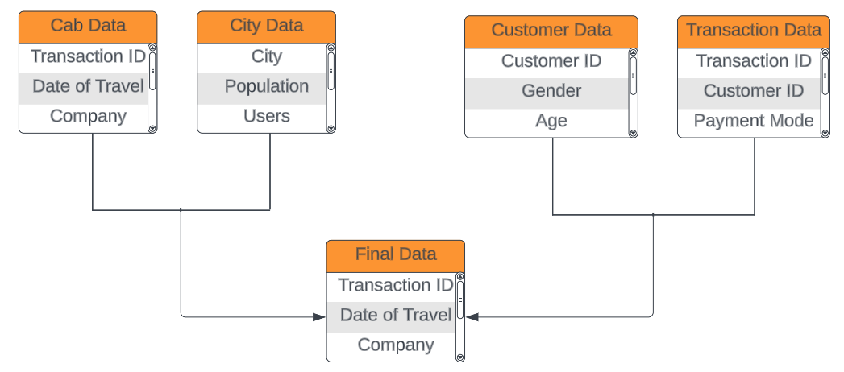
Data Preparation
Merge on City
Merge on Customer ID

Slide 4
Data Exploration
19 Features( including 6 derived features)
Timeframe of the data: 2016-01-31 to 2018-12-31
Total data points :359,392
Assumptions:
Outliers are present in Price_Charged feature but due to unavailability of trip duration details ,we are not treating this as outlier.
Profit of rides are calculated keeping other factors constant and only Price_Charged and Cost_of_Trip features used to calculate profit.
Users feature of city dataset is treated as number of cab users in the city. We have assumed that this can be other cab users as well(including Yellow and Pink cab)
As the dataset is biased such that Yellow Cab transactions are greater than the Pink Cab transactions, number of users based on transaction IDs will not be a valid argument for data analysis.

Slide 5
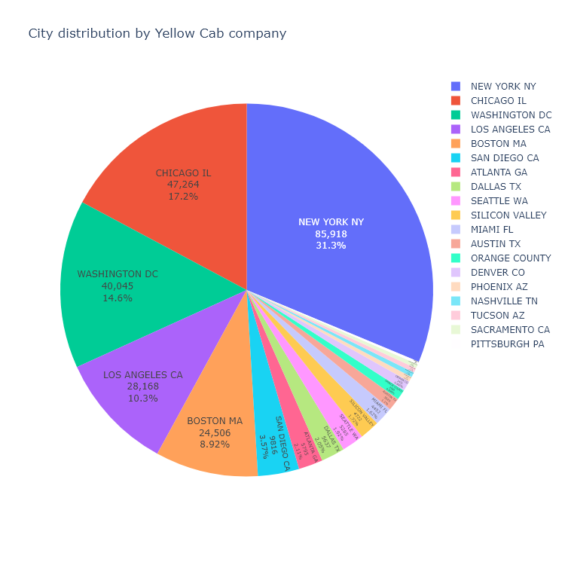
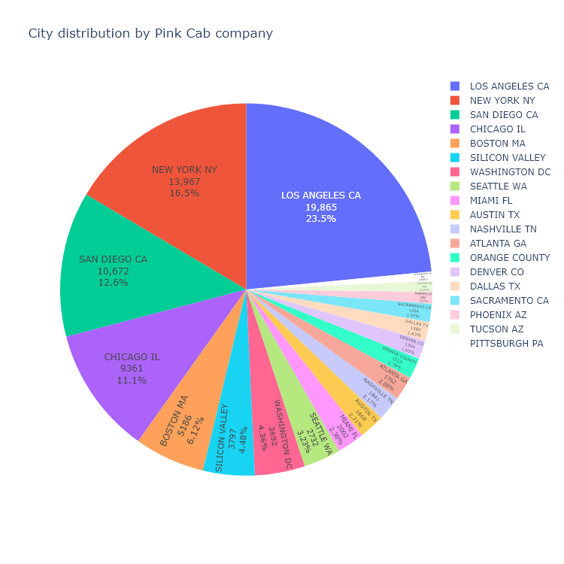
Data Exploration

Slide 6
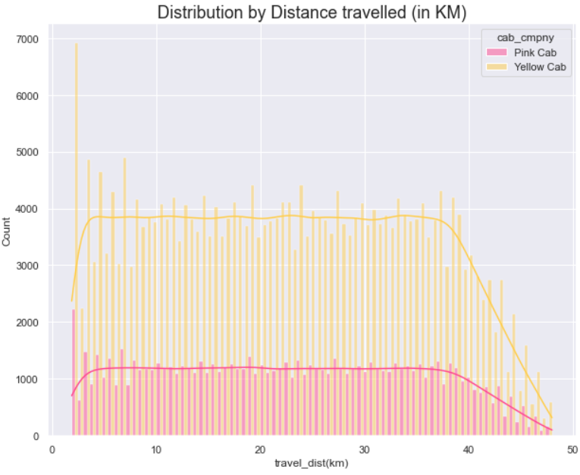
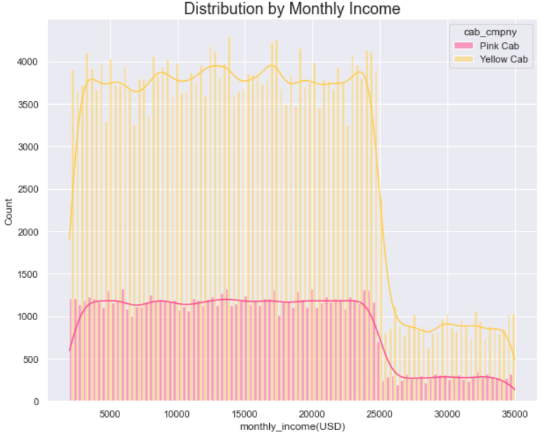
Data Exploration

Slide 7
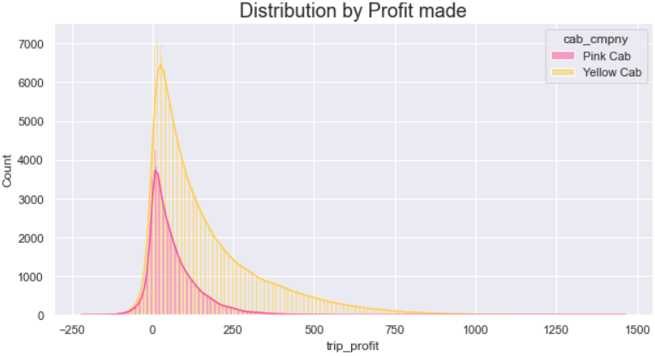
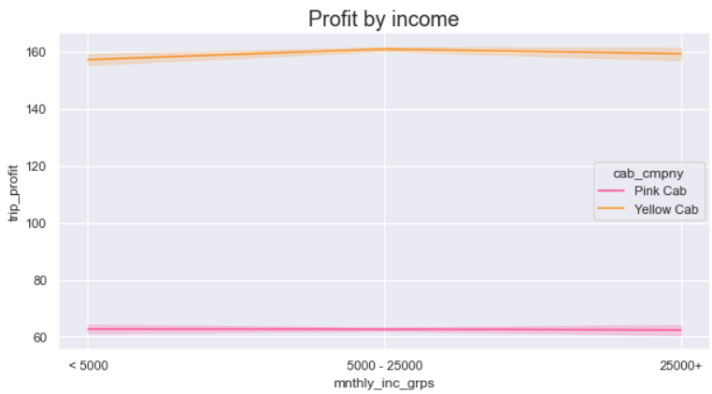
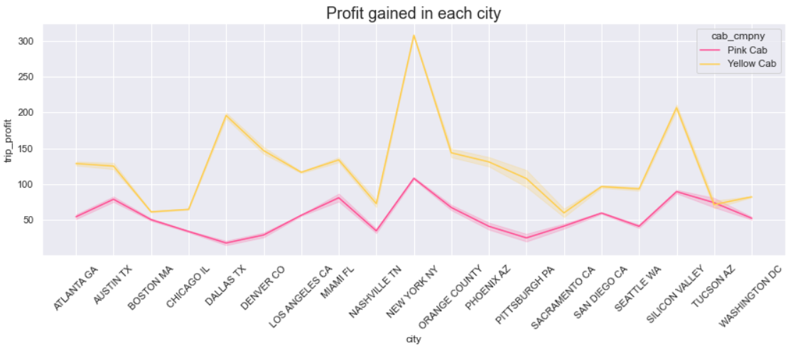
Profit Analysis
Profit Analysis
The overall profit, as seen by these graphs, can be concluded that it is higher for Yellow cab company as compared to Pink cab company

Slide 8
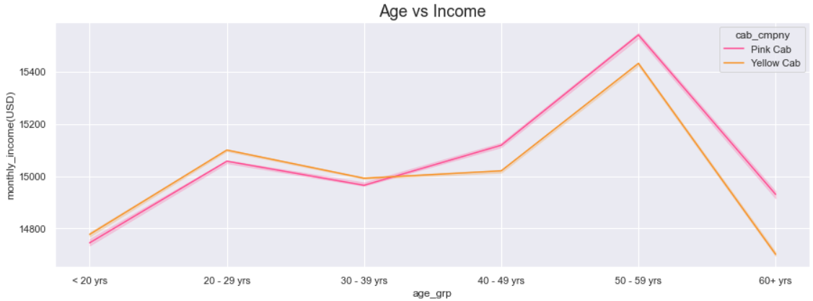
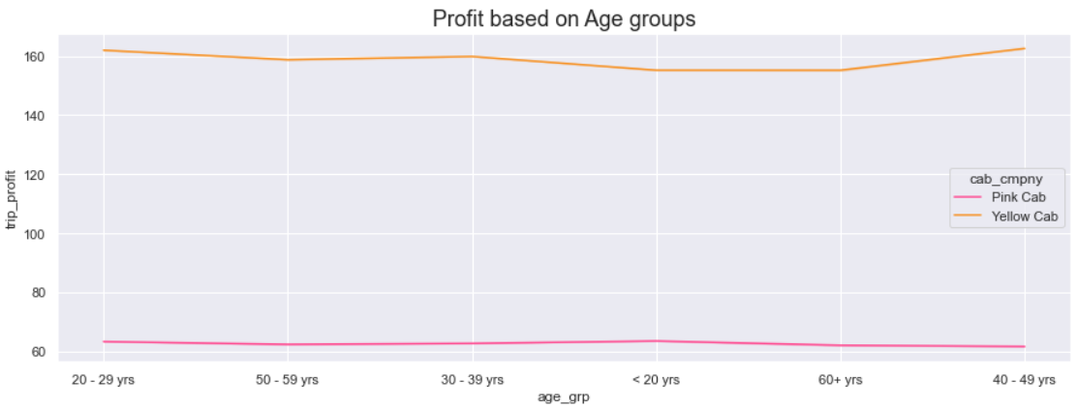
Profit Analysis
Profit Analysis
As evident from the graphs, as Age of the customer increases, the Monthly Income also increases.
Although, the income increases, there is no difference in the profit gained for different age groups for both the cab companies.
The increase in age doesn’t affect the profit and it’s safe t assume that customers with different age access the cabs based on other factors.

Slide 9
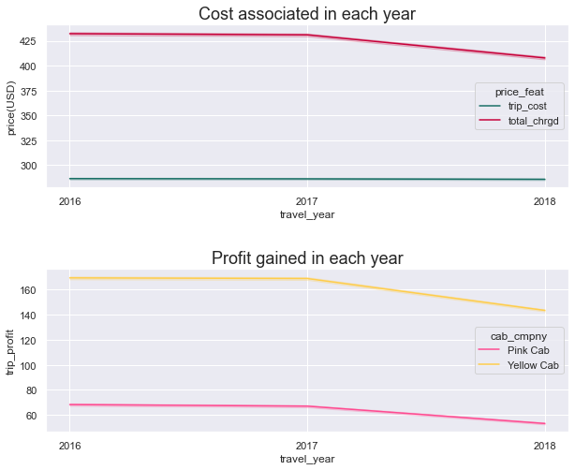
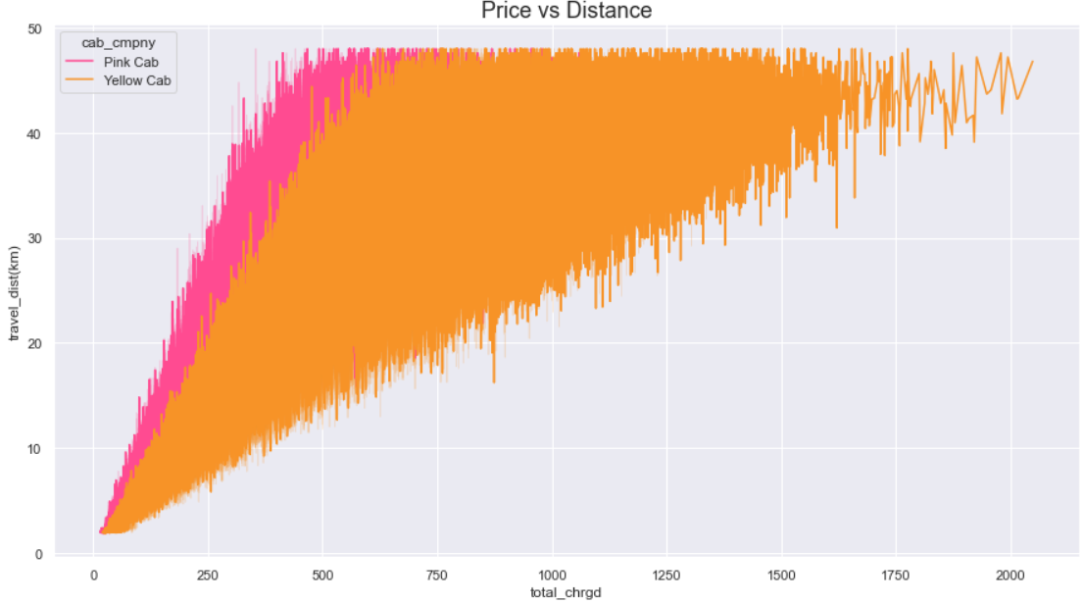
Cab Price-Profit Analysis
Yellow Cab company price increases rapidly with increase in travel distance unlike Pink Cab where the increase is slow.
However, the Profit gained by Yellow Cab is higher throughout the years.

Slide 10
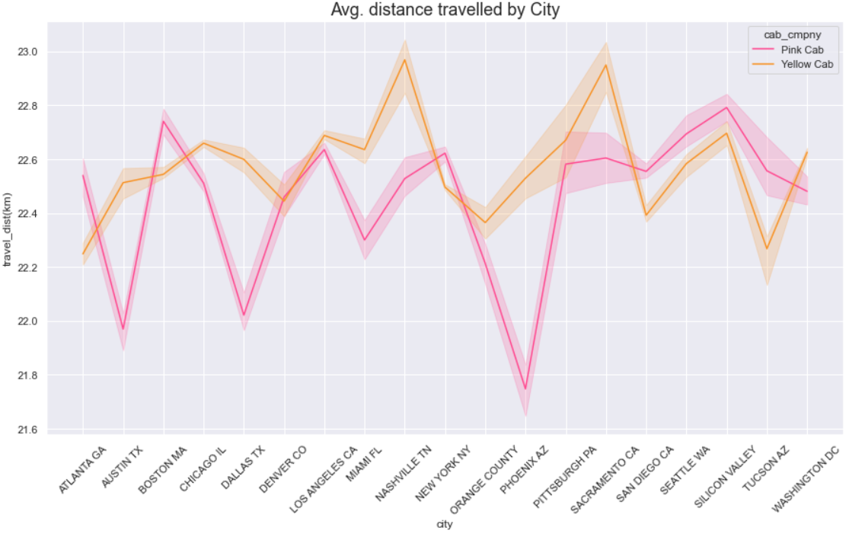
Demand by City
The Avergae Distance travelled in each city is consistent with respect to customers using Yellow Cabs.
Whereas when we take a glance at the graph, there is significant drop in average distance travelled by customers using Pink Cabs in some of the cities such as Austin TX, Dallas TX, and a huge drop in Phoenix AZ.

Slide 11
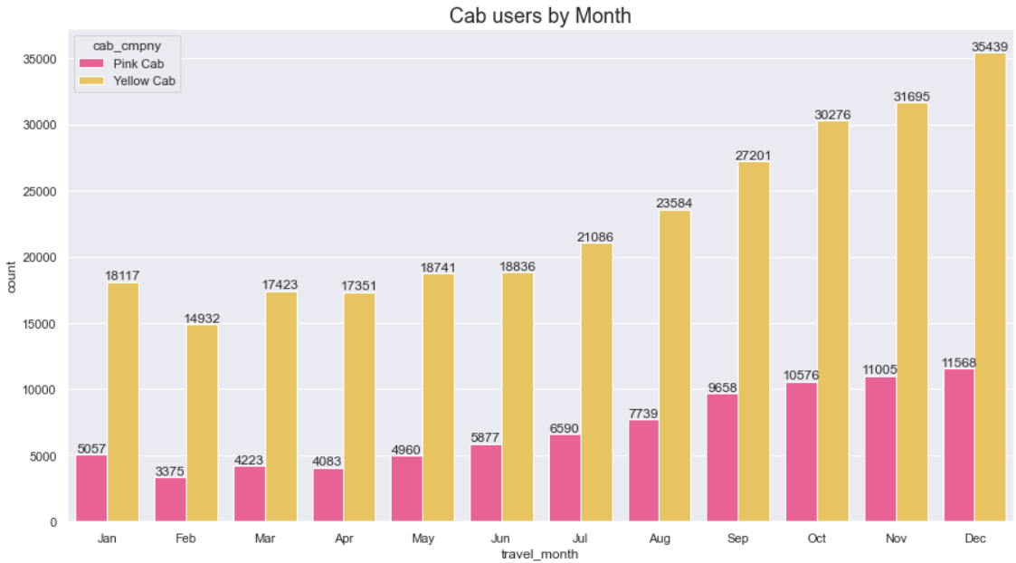
Demand through Months

Slide 12
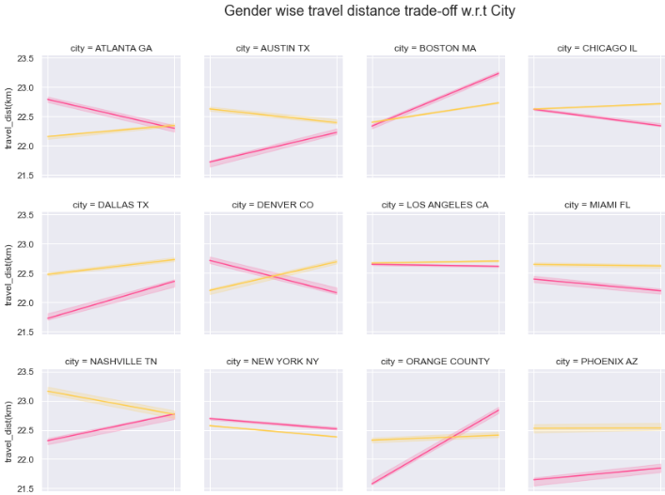
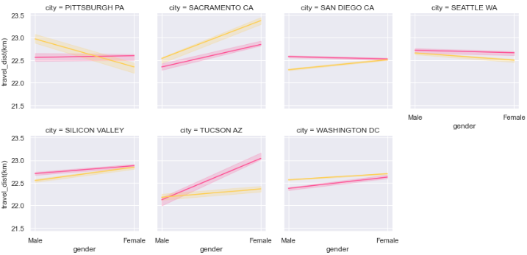

Analysis by Gender

Slide 13
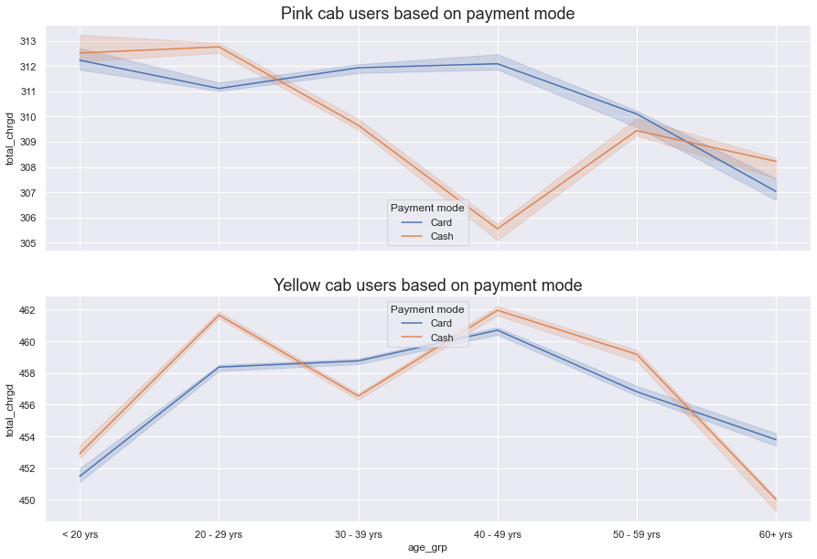
Age Analysis
The trend with Pink Cab middle aged customers while choosing the mode of payment is high with card payment unlike cash payment which is quite low.
Whereas the trend is different with the Yellow Cab customers as both the payment modes are high in demand when used by the middle aged group.

Slide 14
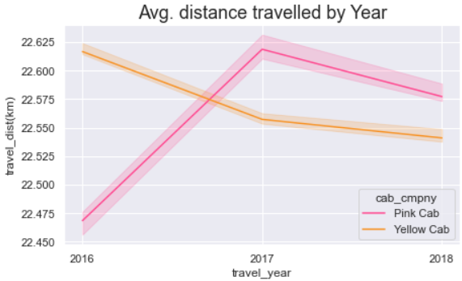
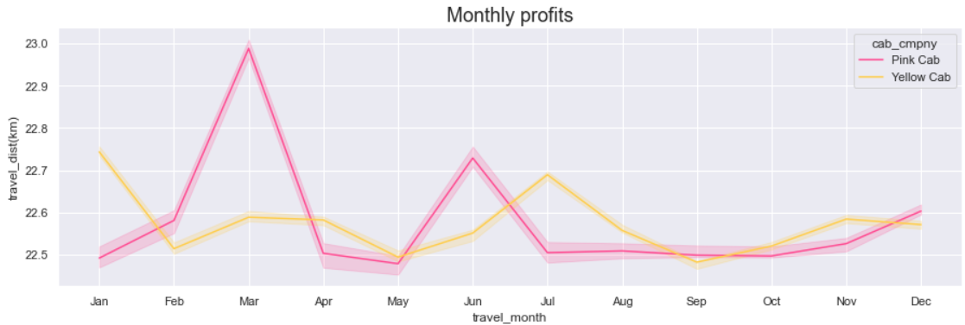
Seasonal Analysis

Slide 15
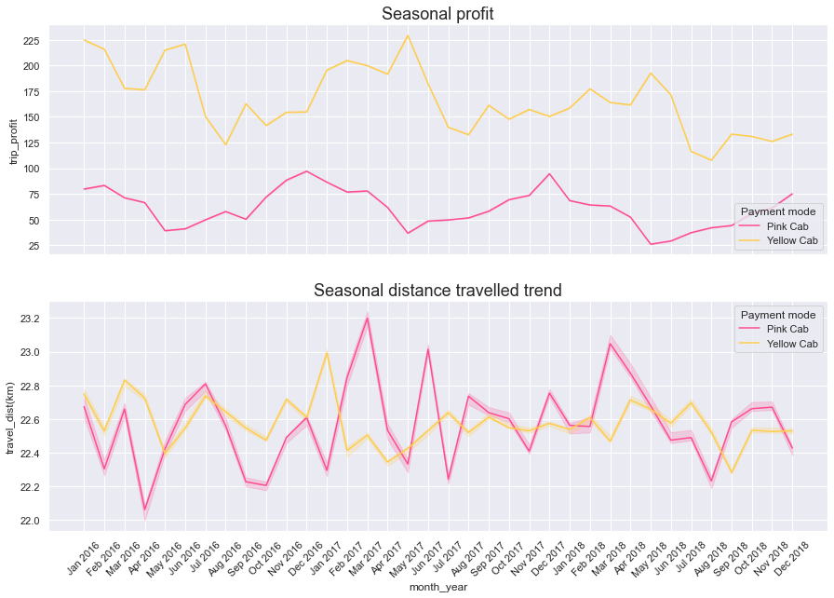
Seasonal Trend
There is consistency in the distance travelled by customers choosing Yellow Cab as compared to Pink Cab.
We see major dips in average distance travelled by customers using Pink Cab in March, Aug & Sep in the year 2016.

Slide 16
Recommendations
We have evaluated both the cab companies on following points and found Yellow cab better than Pink cab:
Customer Reach : Distribution between Yellow Cab users versus Pink Cab users per city shows that there are high transactions with the former company.
Profit Analysis :
High profit gain by Yellow Cab company is seen in different cities,
Increased profit with different age groups, and
Rapid high profit per trip with increasing distance travelled.
Demand :
Consistency in demand for Yellow Cab can be seen across different cities.
Increases number of Yellow Cab users can be seen throughout the months.
Both payment modes can be seen to be used during trips by Yellow Cabs unlike the Pink Cabs which have low cash usage to pay for trips.
Seasonal Trend : Consistency in distance travelled is observed from trips by Yellow Cab company through the years from 2016 – 2018 whereas it is inconsistent with lot of highs and lows from trips by Pink Cab company
On the basis of above points, we will recommend Yellow cab for investment.

Slide 17
Thank You

